Slide 1
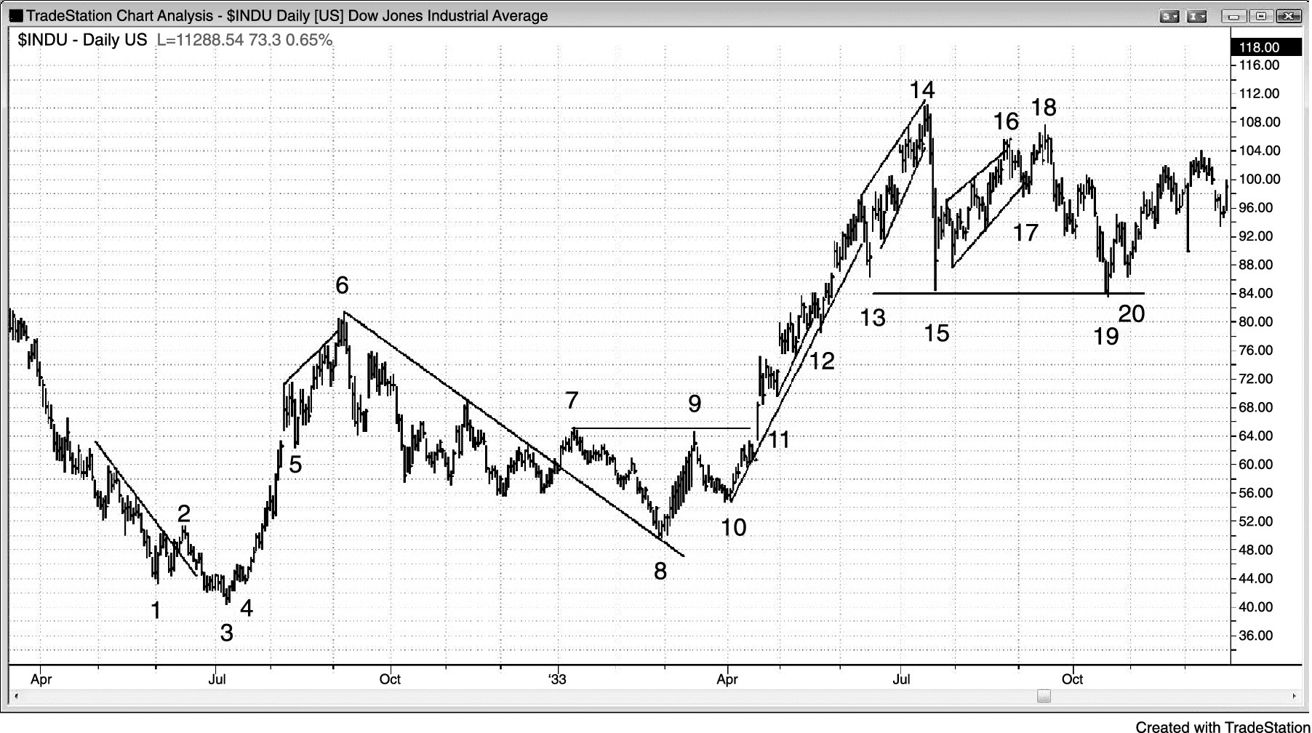
FIGURE 22.1 Price Action Has Not Changed over Time

Slide 2
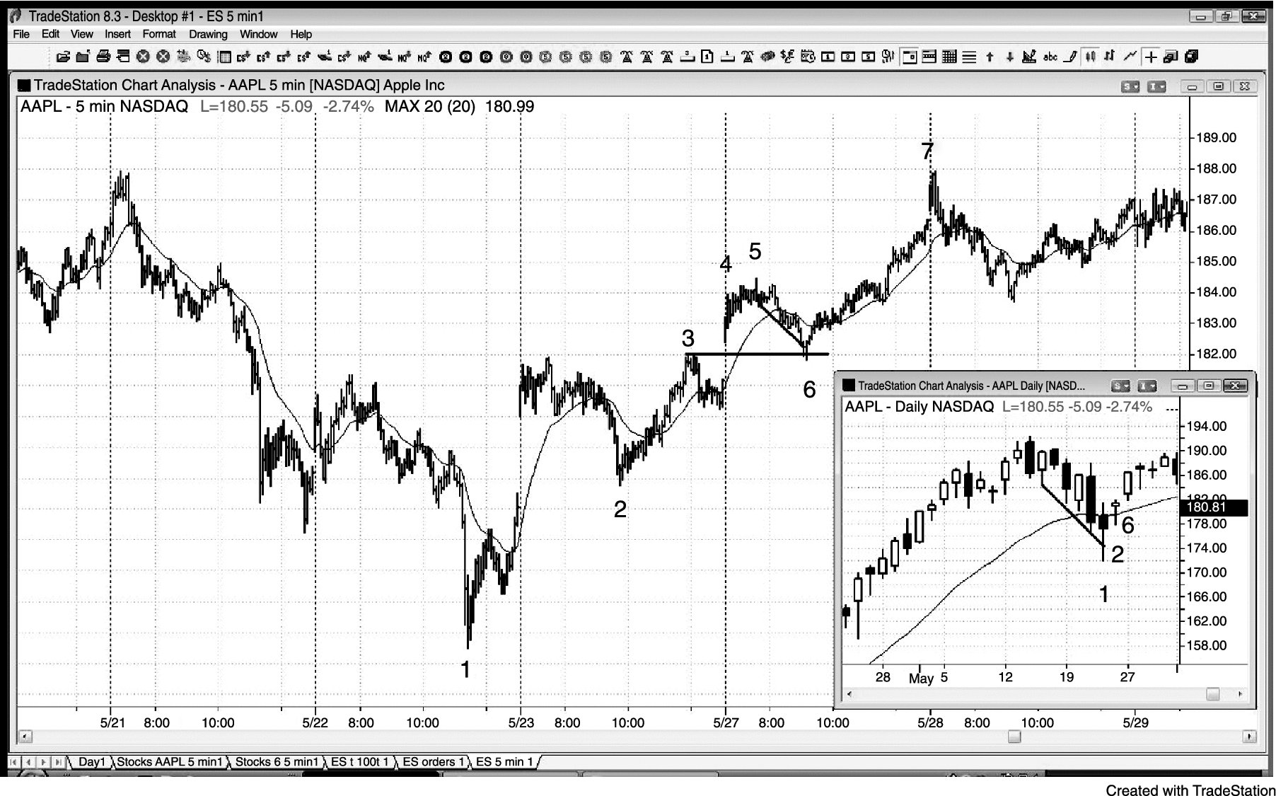
FIGURE 22.2 Gap Pullbacks

Slide 3
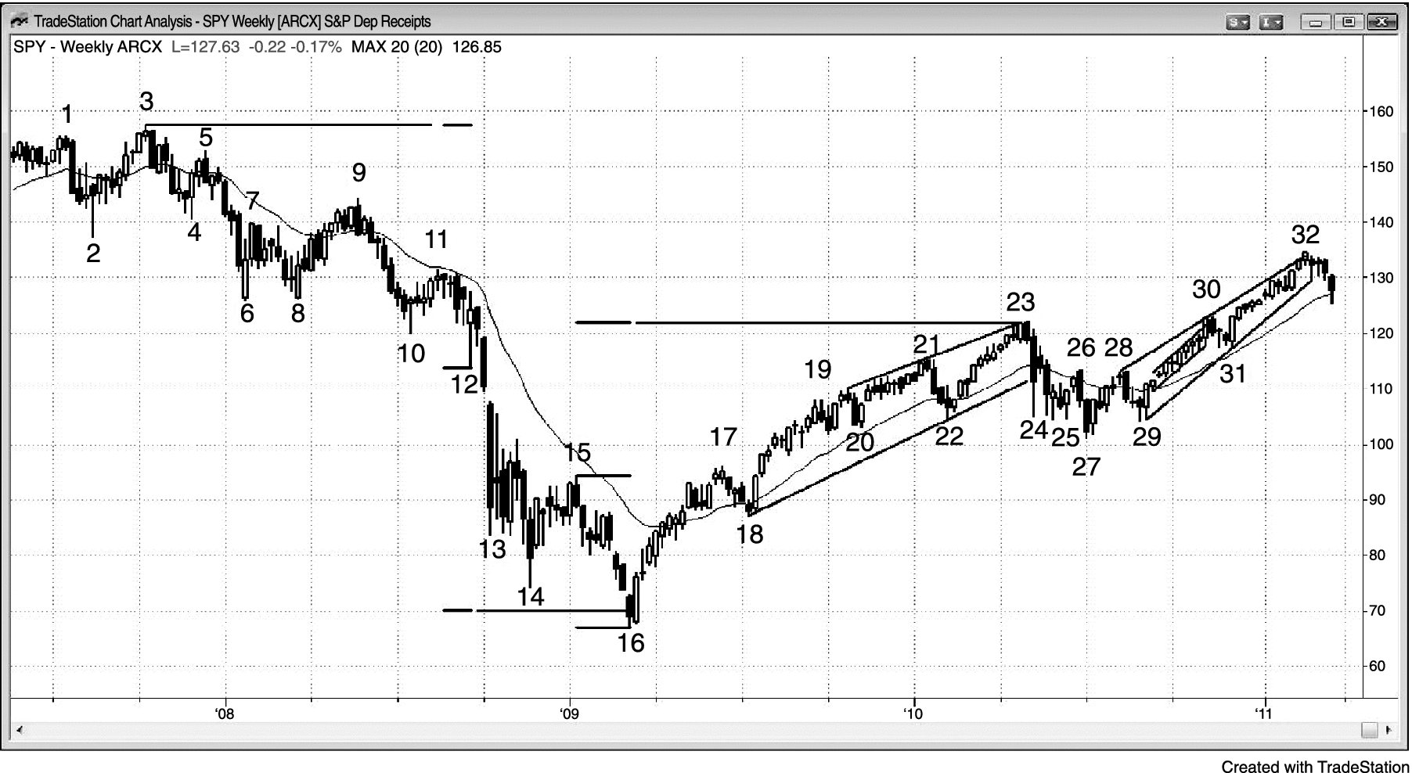
FIGURE 22.3 The Weekly SPY

Slide 4
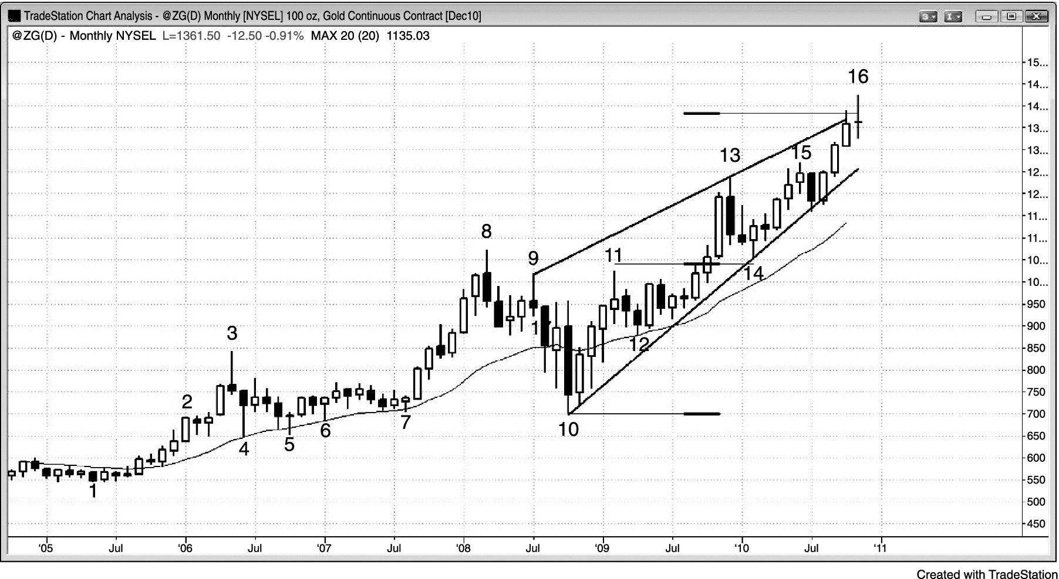
FIGURE 22.4 Monthly Gold Wedge Channel

Slide 5
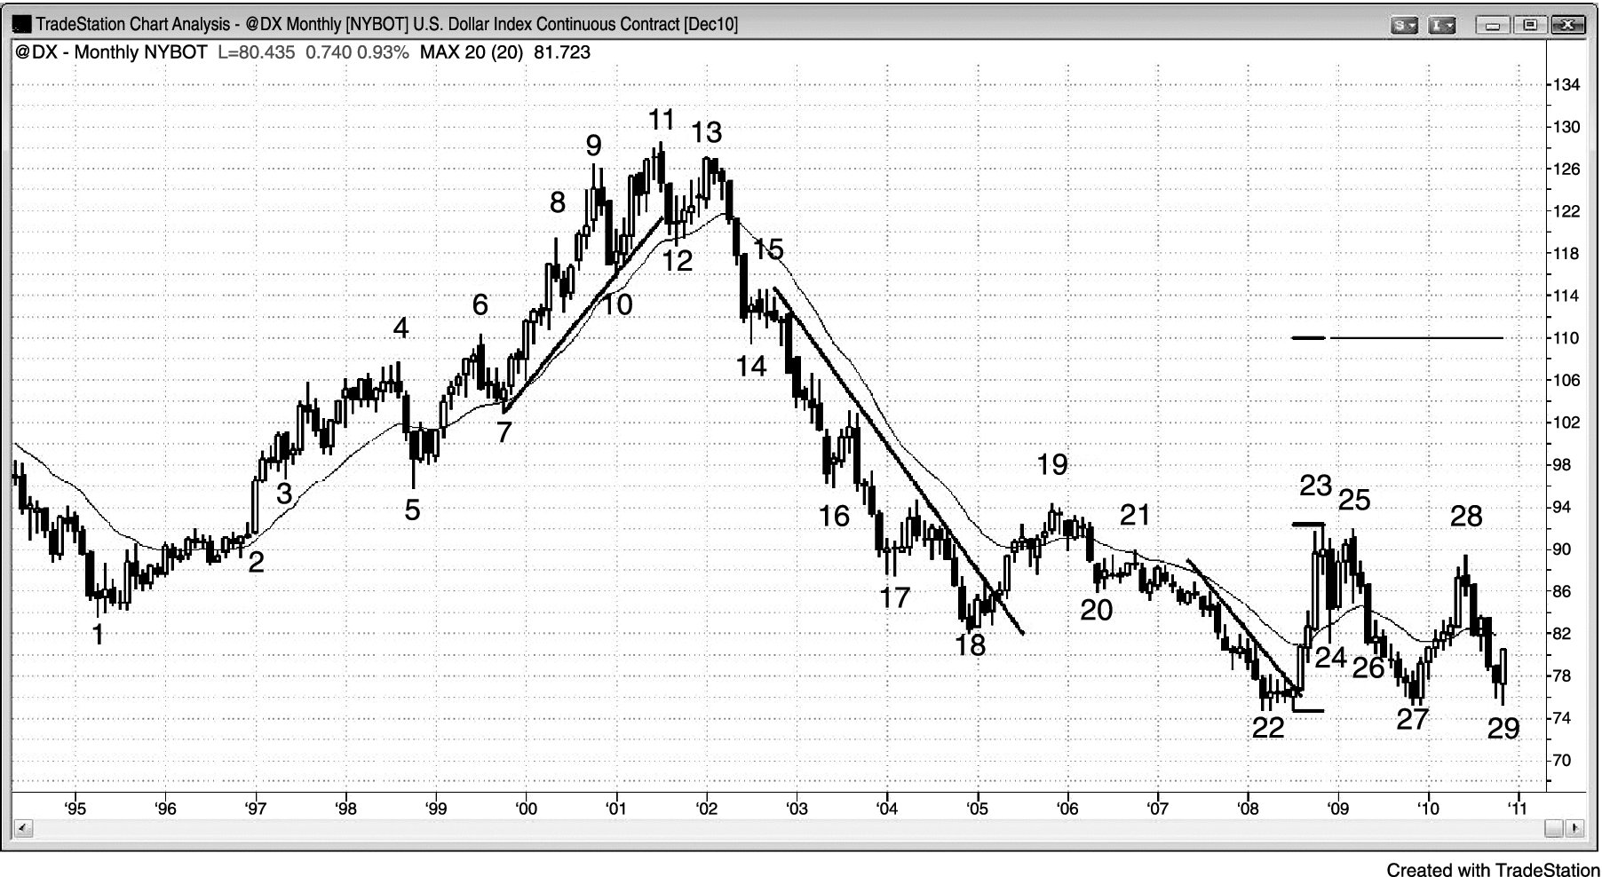
FIGURE 22.5 Monthly Dollar Index Futures

Slide 6
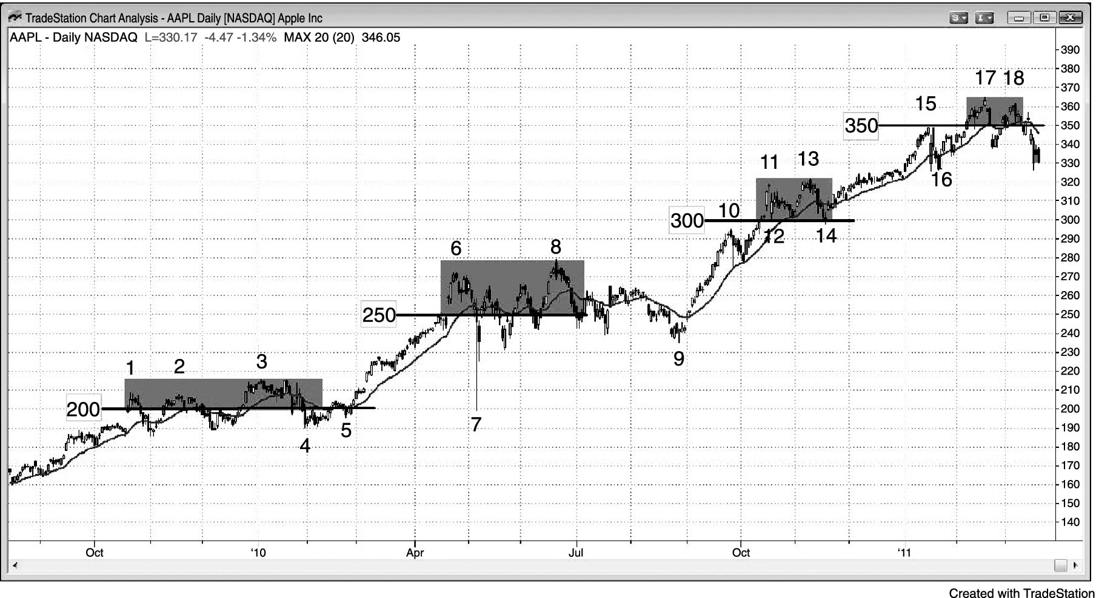
FIGURE 22.6 Round Numbers Can Be Support and Resistance

Slide 7
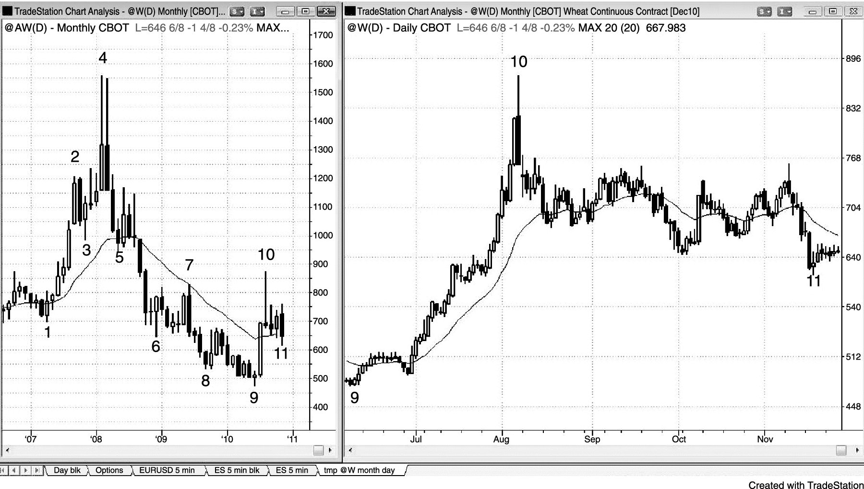
FIGURE 22.7 The Daily and Monthly Charts Can Be in Opposite Trends

Slide 8
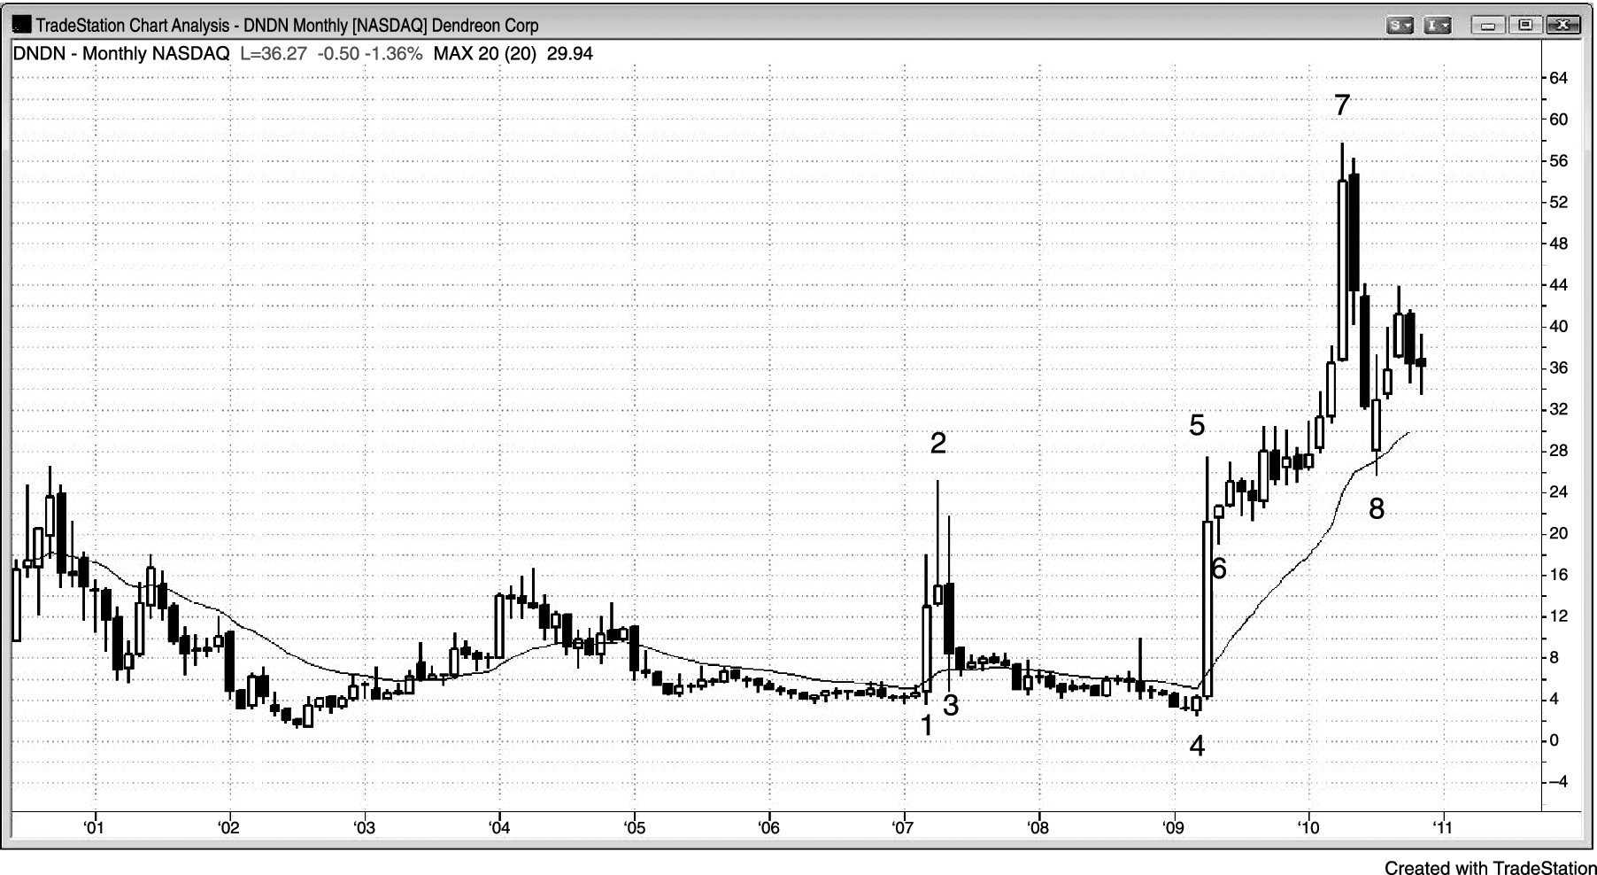
FIGURE 22.8 News Can Move a Stock

